Slide 1
OMIS 694 – Big Data Analytics
EMC Education Services
Data Science & Big Data Analytics
FPC Loan Advisor
Naga Venkata Durga Mahesh Devarapalli (z1792056)
Rahul Reddy Vodoor (z1789744)
Nisar Ahmed Shaik (z1780816)
Manoj Eedupuganti (z1805657)
Akarsh Vinod Ghanathay (z1804713)
Date : April 27, 2017
Notes:
EMC Ed Services CA and DCA Launch Master V8

Slide 2
Situation & Project Goals
Situation
FPC, a Financial Planning Company aims at expanding the set of services. - Provide Loan advice on-the-fly. (probability score)
Basic level of information needed from the customers.
Eliminate the need for sensitive data.
(ex. Credit scores, employment history, existing debt etc.)
4. FPC aspires to draw more customers by offering more focused, personal financial services.
Goals of “FPC Loan Advisor” Project
Develop an accurate predictive model with limited borrower data.
Model needs to determine a customer’s probability of securing a loan along with other recommendations & feedback.
Determine necessary thresholds & recommendations to FPC.

Slide 3
Project Goals
Project Sponsor/Analyst Standpoint
Limit the level of information needed from prospective loan borrowers.
Develop effective model/models ? (Naïve Bayes/Logistic ?)
Determine the accuracy of the suggested model/models.
Suggest thresholds for stakeholders & other recommendations to FPC.
End-user Standpoint
Probability of securing a home loan.
Any other useful insights for the customers.

Slide 4
The Data Analytics Life Cycle
How do we approach this problem ?
Gather data for model planning & building.
Perform data cleaning prior to building the model.
Develop possible models relevant to the problem.
Focus on a single model for initial study.
Create training & test data sets.
  Helps compare predicted outcomes with known values.
  Improves the efficiency of the prediction model.
  Run iterations to ensure that the best predictive model is built for further predictions.

Slide 5
Quality of Data
Data Haves & Have-nots, Cleaning
Housing loan information assembled by the federal agencies (HMDA)
  Repository of all the housing loan & application data (approx. 150,000 records)
  Gathered/updated on an yearly basis.
  Most accurate & genuine information on loan issue trends.
  Data segregation based on the geographic locations such as counties & states.
Factors that might have impacted the loan decision in the past.
  Major - Loan type, Purpose, Amount, Annual household income.
  Minor - County, Ethnicity, Race, Sex etc.
Perform Data cleansing wherever necessary.
  Eliminate bad data or clutter.
  Use approximations if necessary.

Slide 6
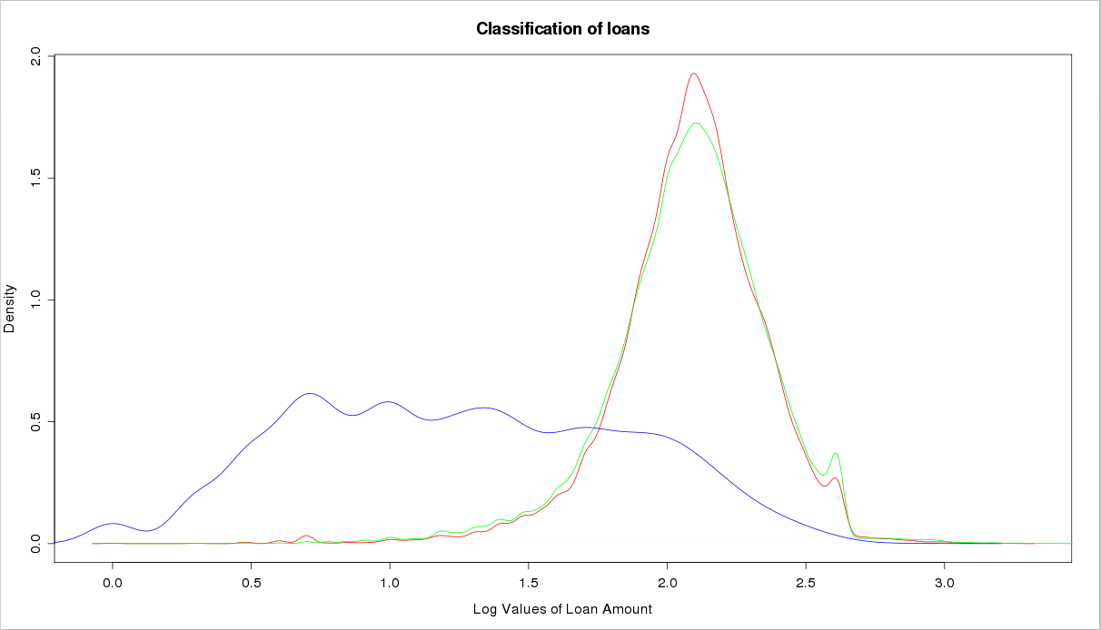
Data Analysis & Visualization
Distribution of Loan Amount & Purposes
Home Improvement Re-finance Home Purchase
Primary focus is on Home purchase & re-finance categories.
Exclude the “home improvement” category.

Slide 7
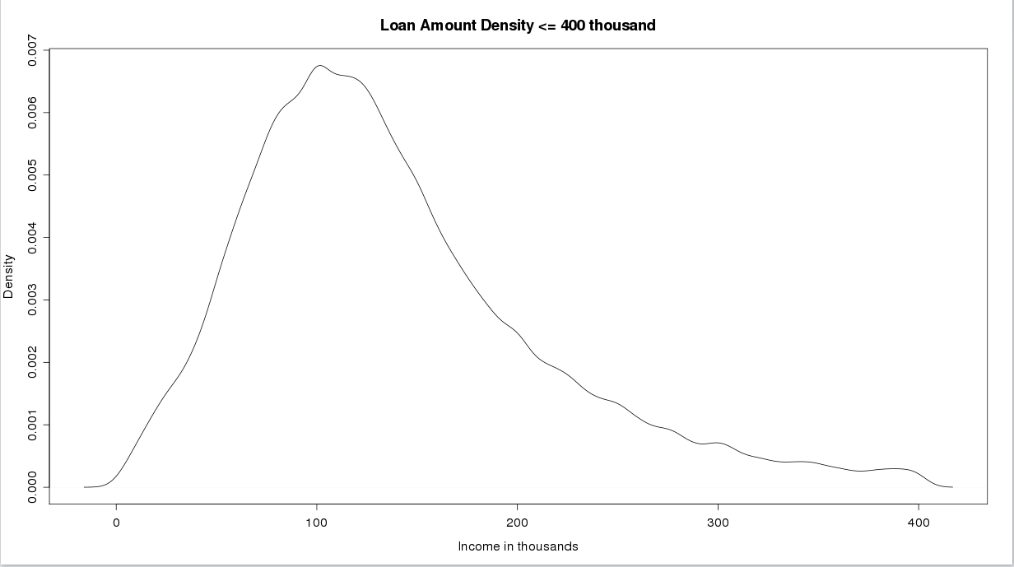
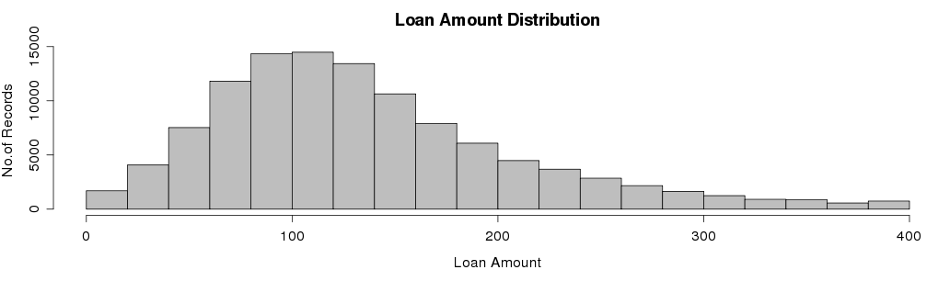
Data Analysis
Final Sample Data
Loan amount distribution between 0 - 400 thousand is considered.
Makes the entirety of the data set for developing the initial model.
Smoothened distribution.
No abnormal spikes.
Allows for an in-depth model planning & building for different data ranges & categories.

Slide 8
Data Analysis
Model Planning
Determine methods, techniques to be followed for model scoring.
  Model : Logistic Regression (with over 150,000 records)
  Overview : Predict the probability of a prospective loan borrower securing a loan
  Dependent variable : Binary (loan status granted /denied).
  Post-Data Cleaning
    Training Sample : 22,000 records Testing Sample : 100,000 records.
Explore data to determine relationships between variables.
  Select key variables, both dependent & independent.
Which variables matter ?
  Dependent variable – Loan Status (Approved/Denied).
  Drivers/ Input variables – loan amount , loan type, applicant income, median income, county name, personal information etc.)
Any other focus areas/ emphasis ?
    We can target audience based on geographic location, household income & other factors.

Slide 9
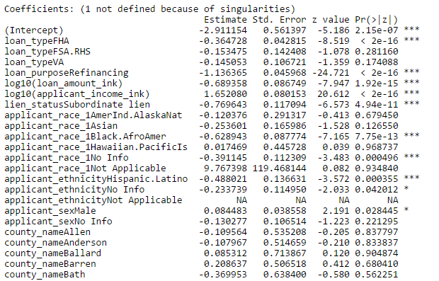
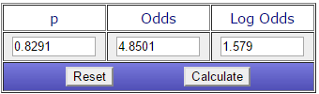
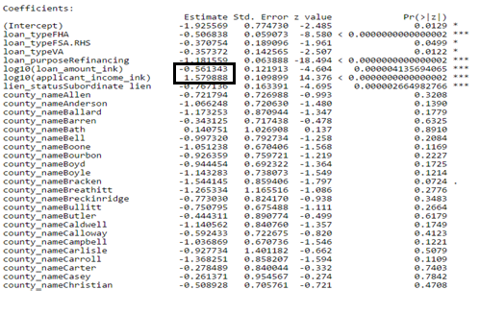

Data Analysis
Model Building – Logistic Regression
Coefficients with Personal Information
Significance of the coefficients
Applicant Income
For a unit increase in the applicant’s income (i.e. $1000) , there is a 385% increase in the odds of securing a loan.
Loan Amount
For a unit increase in the loan amount
(i.e. $1000), there is a 43% decrease in the odds of securing a loan.
Coefficients without Personal Information

Slide 10
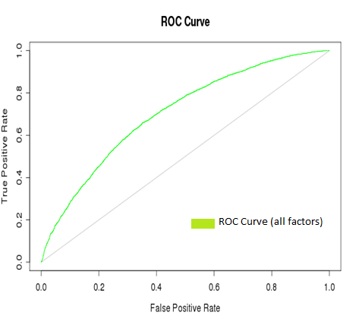
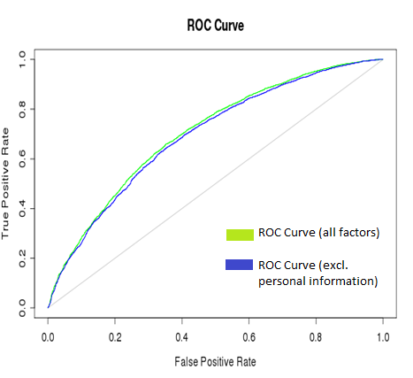
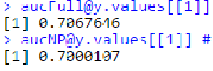
How do we fair ? ROC Curve
      1. aucFull – ROC curve with all factors (incl. Personal information).
      AUC = 0.7067
2. aucNP – ROC Curve excluding personal information.
AUC = 0.7000
No significant difference exists between the ROC curves with & without personal information.

Slide 11
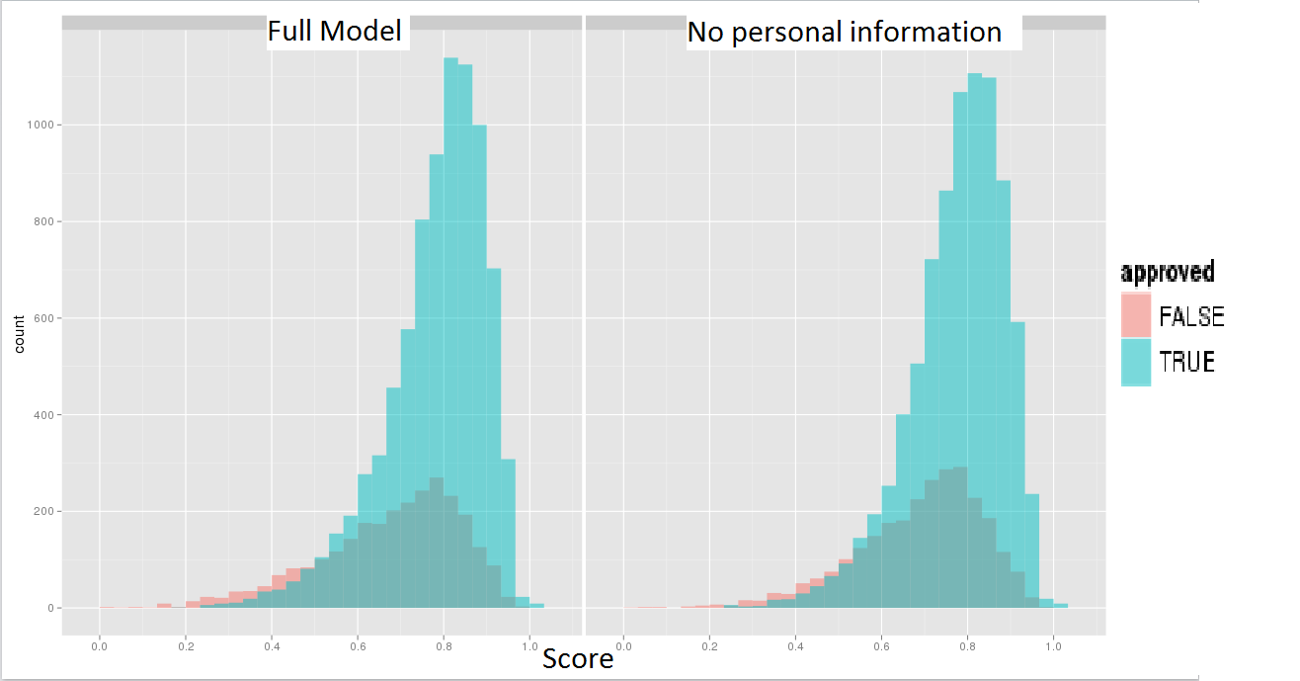

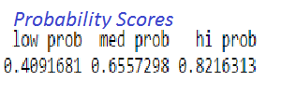
Plots
Score densities & Probabilities
Count
Score Density Plot - Distribution of loan approved vs denied for our predicted model.
Confusion matrix gives the probability of approval in each bin.
Probability of securing a loan in high probability bin is high as desired.
TPR = TP / (TP+FP) *100

Slide 12
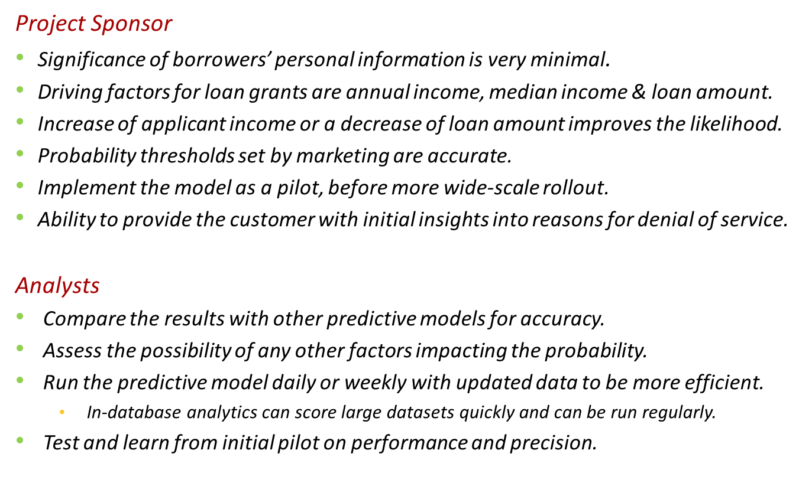
Recommendations

Slide 13
Thank You !

